Slide 1

Learning Objective
I will add and subtract positive integers.
Enter quietly, please be ready with the following on your desk:
Whiteboard
Whiteboard marker
Exercise Book
Pencil, pen, ruler and red pen
Diary
Calculator
Device – charged or borrowed from Library before maths

Slide 2


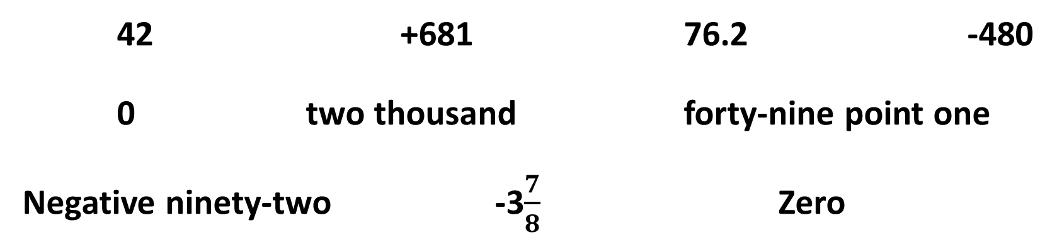
Daily Review
VOCABULARY
Integer – A whole number.
An integer is a whole number.
This includes all of the positive whole numbers, all of the negative whole numbers and zero (which is neither positive nor negative).
CFU
What is an integer?
CFU
Is zero an integer?
We assume that a number with no +/- sign is positive.
Which of these are integers?
42 +681 76.2 -480
0 two thousand forty-nine point one
Negative ninety-two -3$\frac{7}{8}$ Zero

Slide 3


Greater Than, Less Than
Daily Review
> <
Greater than Less than
Remember the greedy crocodile always eats the bigger number!

Slide 4

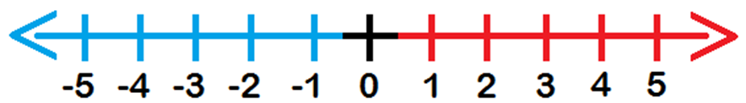
Daily Review
HINT
The greedy crocodile always eats the bigger number
Sentence Structure
____ is greater than ___.
Which is bigger?
0 or 3
2 or -7
-4 or 4
-1 or -4
0 < 3
2 > -7
-4 < 4
-1 > -4
Whiteboards
29 or 27
222 or -333
-961 or -901
-47 or 389

Slide 5
Daily Review
CFU 2
CFU 1
How do we find the LCM using this method? (Step 4)
How do we find the HCF using this method? (Step 3)
To find the HCF and LCM using factor trees:
Draw a factor tree of both numbers.
50
50 = 2 x 5 x 5
Write the numbers in expanded form.
30
30 = 2 x 3 x 5
Highlight the common numbers in the first list.
HCF of 50 and 30
= 2 x 5
= 10
Multiply the highlighted numbers to find the HCF.
LCM of 50 and 30
= 30 x 5
Multiply the second number with the leftover numbers from the first to find the LCM.
= 150

Slide 6
Daily Review
CFU 2
CFU 1
How do we find the LCM using this method? (Step 4)
How do we find the HCF using this method? (Step 3)
To find the HCF and LCM using factor trees:
Draw a factor tree of both numbers.
75
50 = 3 x 5 x 5
Write the numbers in expanded form.
20
30 = 2 x 2 x 5
Whiteboards
Highlight the common numbers in the first list.
Multiply the highlighted numbers to find the HCF.
Multiply the second number with the leftover numbers from the first to find the LCM.

Slide 7
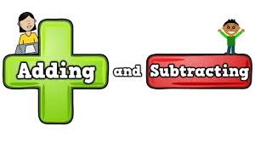
Learning Objective
CFU
What will we learn today?
CFU
I will add and subtract positive integers.
How will you know that you are successful?
Success Criteria
At the end of the lesson, I will be able to:
Decide whether an answer will be positive or negative.
Add positive integers.
Subtract positive integers.

Slide 8
Activate Prior Knowledge
When we ADD a number, does the answer get bigger or smaller?
BIGGER
Which direction do we move to get BIGGER on the number line?
Addition = move to the RIGHT

Slide 9
Activate Prior Knowledge
When we SUBTRACT a number, does the answer get bigger or smaller?
SMALLER
Which direction do we move to get SMALLER on the number line?
Subtraction = Move to the LEFT

Slide 10
Concept/Skill Development
HINT
Subtracting means moving left. ←
Adding means moving right. →
Adding positive integers.
4 + 8
-3 + 5
-12 + 7
-17 + 25
= +12
= +2
Whiteboards
= 12
= 2
Start on the first number.
Which direction are we moving in?
How many places are we moving?
What is the final answer?

Slide 11



Concept/Skill Development
HINT
Subtracting means moving left. ←
Adding means moving right. →
Another way:
Think of it like tug of war around zero.
-3 + 5
There are 3 people on the negative side.
= +2
There are 5 people on the positive side.
= 2
Which side wins?
Will the answer be positive or negative?
Using the column stacking method,
put the large number on top.
Positive
5
- 3
2

Slide 12
Concept/Skill Development
HINT
Subtracting means moving left. ←
Adding means moving right. →
Another way:
Think of it like tug of war around zero.
-12 + 7
There are 12 people on the negative side.
= -5
There are 7 people on the positive side.
Will the answer be positive or negative?
Using the column stacking method,
put the large number on top.
Negative
12
- 7
5

Slide 13
Concept/Skill Development
HINT
Subtracting means moving left. ←
Adding means moving right. →
Another way:
Think of it like tug of war around zero.
Whiteboards
-17 + 25
There are 17 people on the negative side.
There are 25 people on the positive side.

Slide 14
Concept/Skill Development
HINT
Subtracting means moving left. ←
Adding means moving right. →
Another way:
Think of it like tug of war around zero.
-982 + 135
There are 982 people on the negative side.
= -847
There are 135 people on the positive side.
Will the answer be positive or negative?
Using the column stacking method,
put the large number on top.
Negative
982
- 135
847

Slide 15
Concept/Skill Development
HINT
Subtracting means moving left. ←
Adding means moving right. →
Another way:
Think of it like tug of war around zero.
Whiteboards
-633 + 117
There are 982 people on the negative side.
There are 135 people on the positive side.

Slide 16
Concept/Skill Development
HINT
Subtracting means moving left. ←
Adding means moving right. →
Subtracting positive integers.
12 - 9
7 - 13
-2 - 6
-8 - 8
= +3
= -6
Whiteboards
= 3
Start on the first number.
Which direction are we moving in?
How many places are we moving?
What is the final answer?

Slide 17
Concept/Skill Development
HINT
Subtracting means moving left. ←
Adding means moving right. →
Another way:
Think of it like tug of war around zero.
12 - 9
There are 12 people on the positive side.
= +3
There are 9 people on the negative side.
= 3
Will the answer be positive or negative?
Using the column stacking method,
put the large number on top.
Positive
12
- 9
3

Slide 18
Concept/Skill Development
HINT
Subtracting means moving left. ←
Adding means moving right. →
Another way:
Think of it like tug of war around zero.
7 - 13
There are 7 people on the positive side.
= -6
There are 13 people on the negative side.
Will the answer be positive or negative?
Using the column stacking method,
put the large number on top.
Negative
13
- 7
6

Slide 19
Concept/Skill Development
HINT
Subtracting means moving left. ←
Adding means moving right. →
Another way:
Think of it like tug of war around zero.
Whiteboards
-2 - 6
There are 2 people on the negative side.
There are 6 more people on the negative side.

Slide 20
Concept/Skill Development
HINT
Subtracting means moving left. ←
Adding means moving right. →
Another way:
Think of it like tug of war around zero.
Whiteboards
-8 - 8
There are 8 people on the negative side.
There are 8 more people on the negative side.

Slide 21
Guided Practice
HINT
Subtracting means moving left. ←
Adding means moving right. →
Whiteboards
4 + 9
17 - 8
-2 + 9
8 - 12
= 13
= 9
= 7
= -4
-41 + 14
16 - 21
-50 - 12
-64 - 81
= -27
= -5
= -62
= -145
Will the answer be positive or negative?
Using the column stacking method,
put the large number on top.

Slide 22
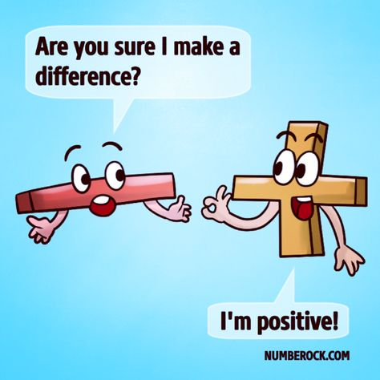
Skill Closure
What have we learnt today?
Lesson Objectives:
I will add and subtract positive integers.
8 - 9
= -1

Slide 23


Independent Practice
Mathematics Page Layout
Open your textbooks to:
Chapter 2.5
Questions: 1 – 2, 5 (every second column), 3, 10

